Slide 1
Point Transformation
Presented by
Nasima Islam Bithi
0421312032

Slide 2
Outline
Point operation
Image negative
Logarithmic transformation
Power law transformation
Image Thresholding
Contrast stretching
Gray-level slicing
Bit plane slicing

Slide 3
Point Operation
Each pixel in the output image is only dependent upon the corresponding pixel in the input image and is independent of its location or neighbors.
Types of point operation:
Linear (negative, identity)
Non-linear (logarithm, inverse logarithm,
power law)
3. Piecewise linear (thresholding, contrast
stretching, gray level slicing, bit plane slicing)

Slide 4
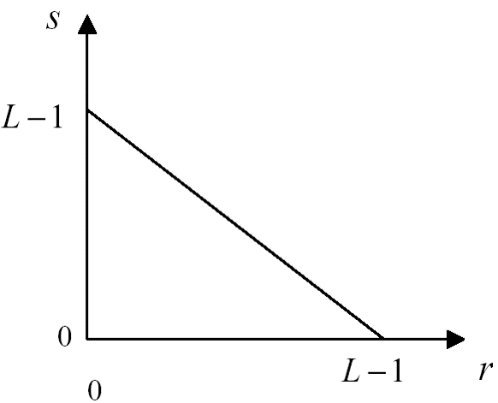
Image Negative
The darkest pixels will become the brightest and the brightest pixels will become the darkest.
Enhances the white or gray information embedded in the dark regions of the image especially when the black areas are dominant in size.
The transformation function used in image negative is :
s = (L-1) – r
where L - 1 is the max intensity value
s is the output pixel value
r is the input pixel value

Slide 5
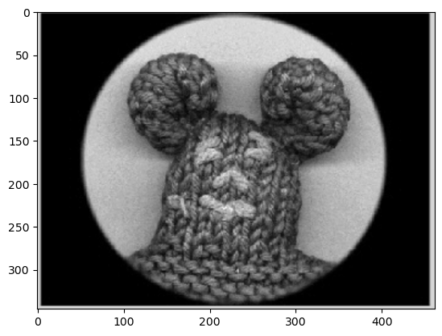
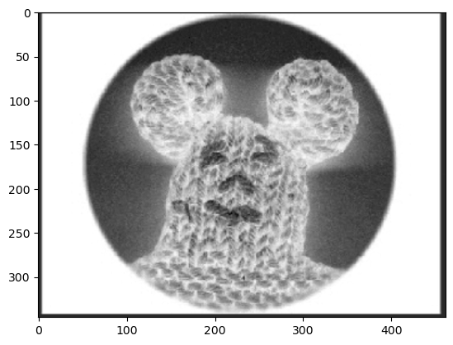
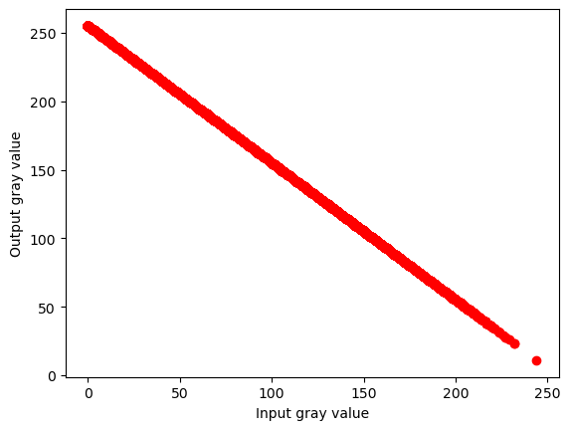
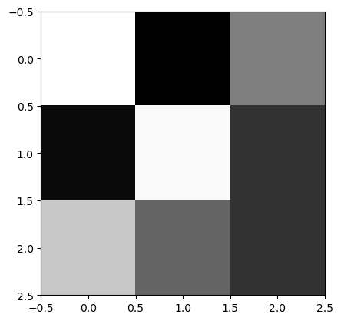
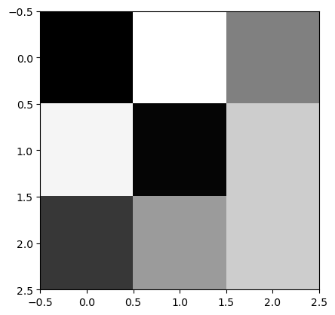
Example: Negative Image
Input Image
Negative Image
255 | 0 | 127
10 | 250 | 50
200 | 100 | 50
0 | 255 | 128
245 | 5 | 205
55 | 155 | 205
Input Image
Negative Image

Slide 6
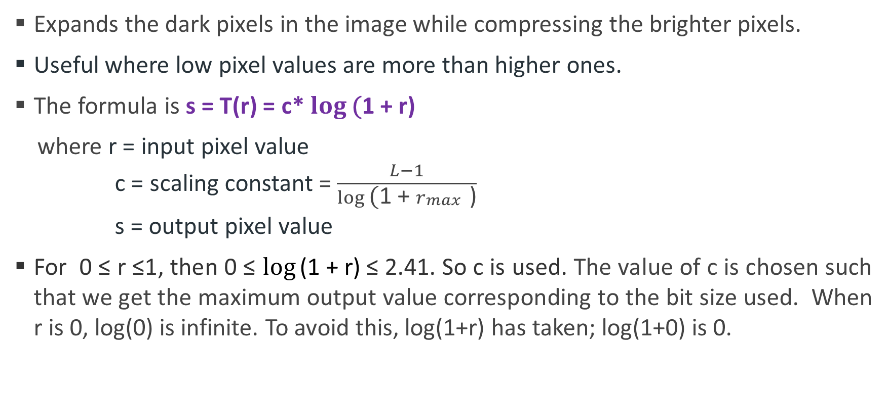
Logarithmic Transformation

Slide 7
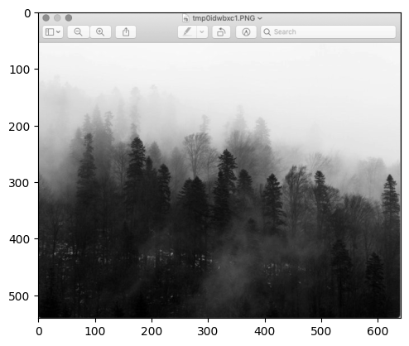
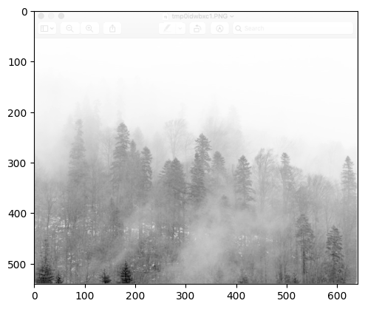
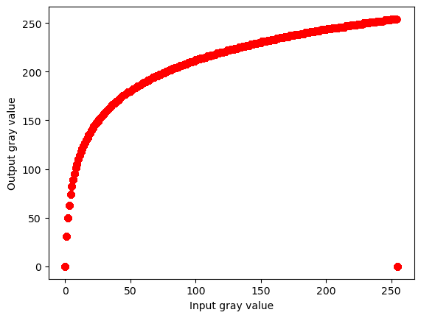
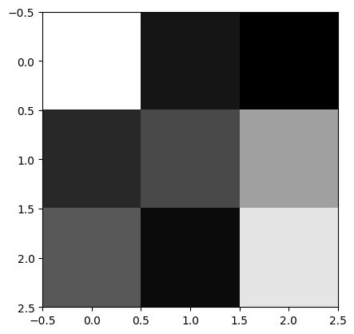
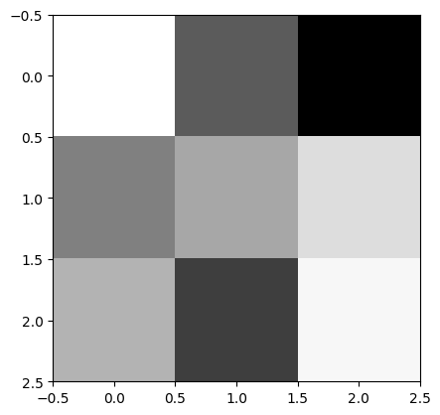


Example: Logarithmic Transformation
Input Image
Transformed Image
Input Image
Transformed Image

Slide 8
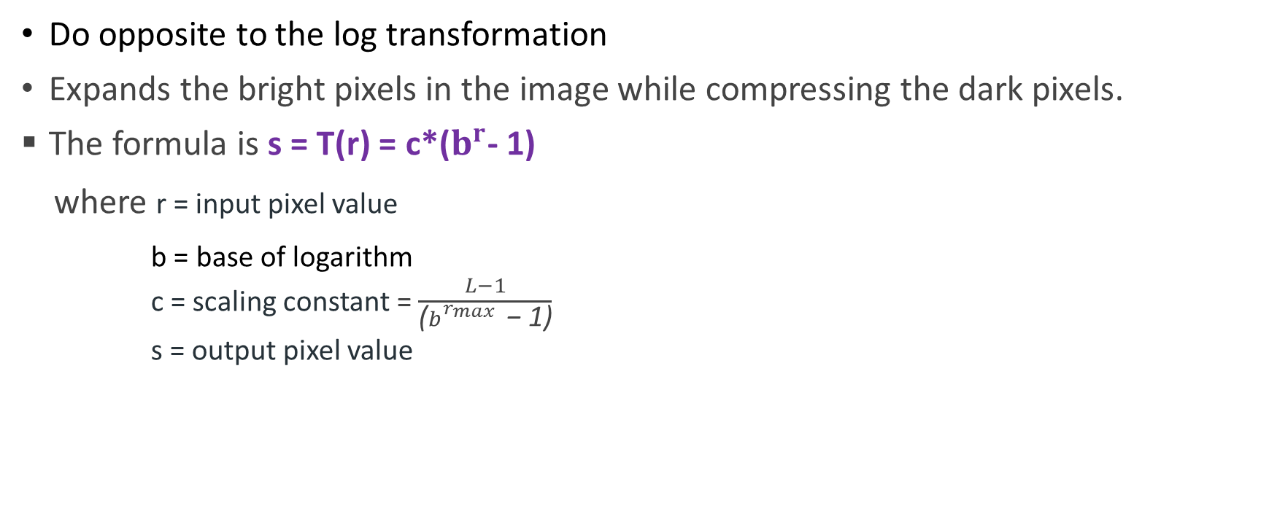
Inverse Logarithmic Transformation

Slide 9
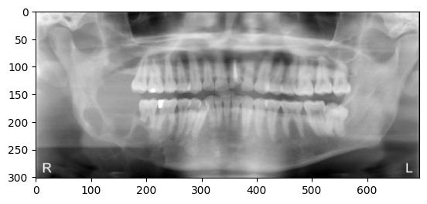
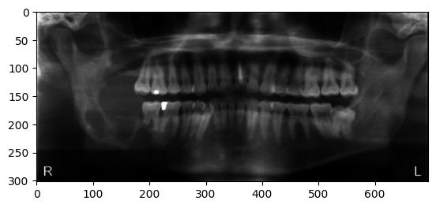
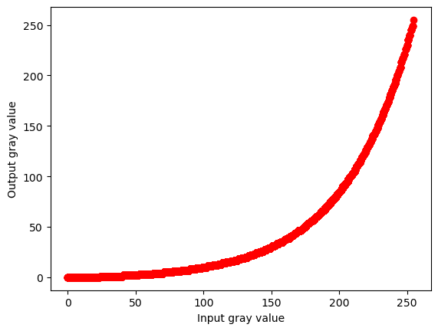

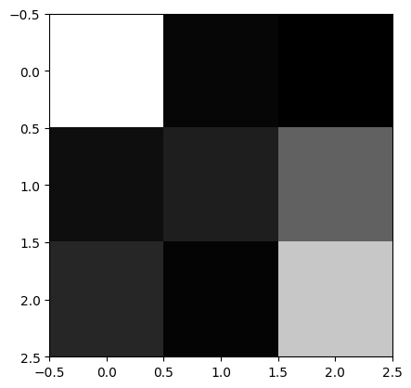

Example: Inverse Logarithmic Transformation
Input Image
Transformed Image
Input Image
Transformed Image

Slide 10
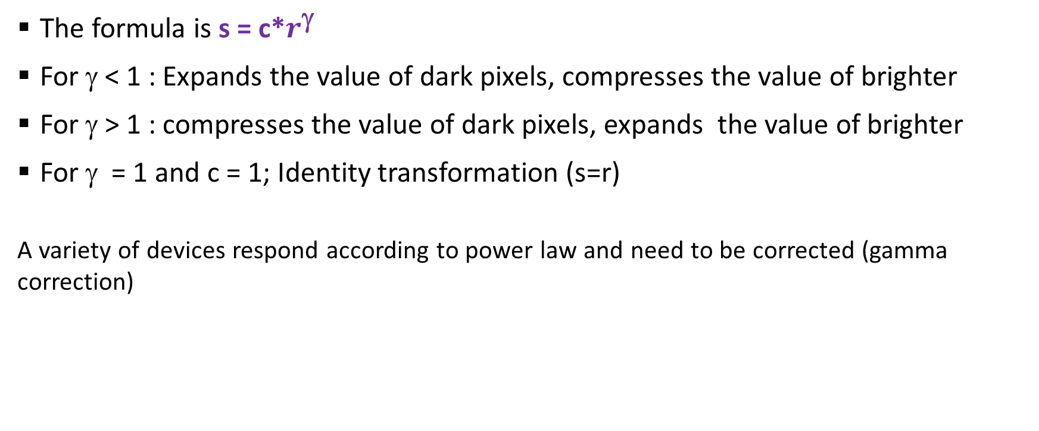


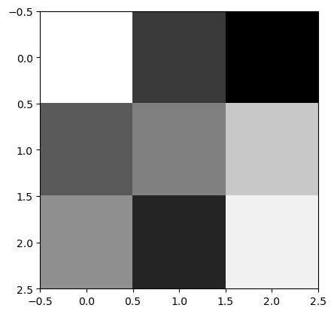

Power Law (Gamma) Transformation
Input Image
Transformed Image with γ= 0.4 & c = 255

Slide 11
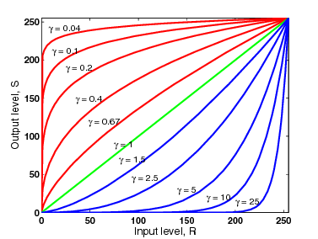
Gamma Coefficient (γ)
Different transformation curves are obtained by varying γ (gamma).
c = 1

Slide 12
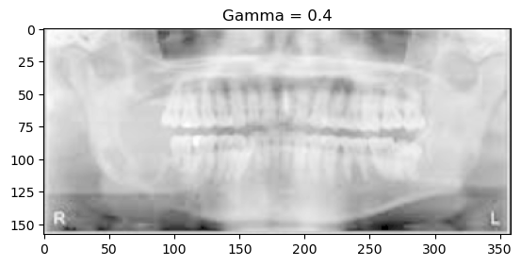
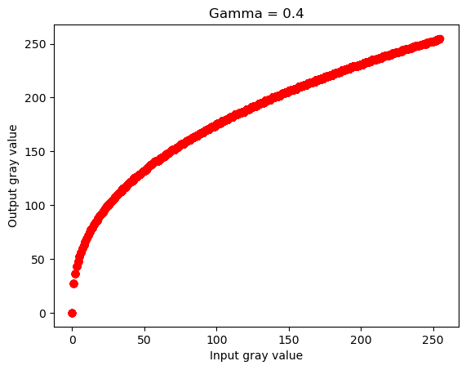
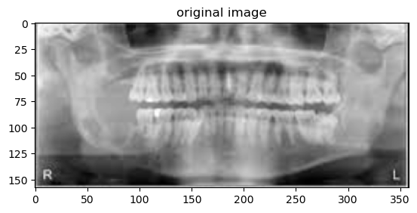
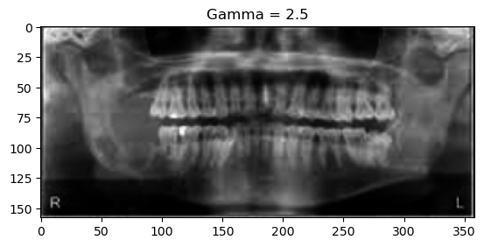
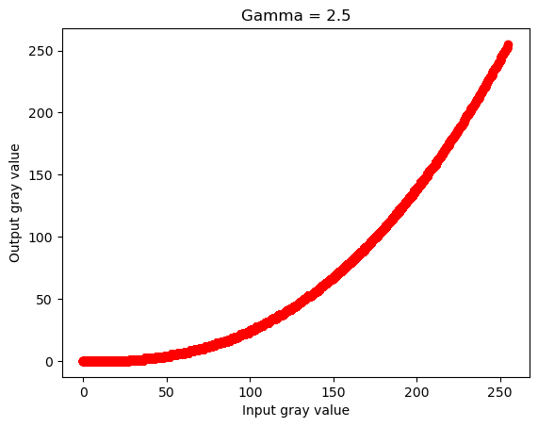
Example: Power Law Transformation

Slide 13
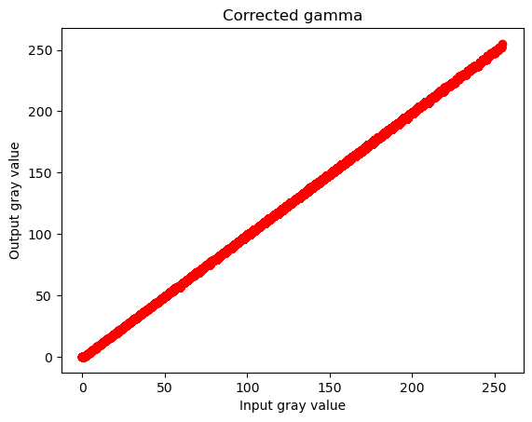



Gamma Correction
Gamma corrected input signal
Transformed output from display
Final output
Input (r)
Output (s’)

Slide 14
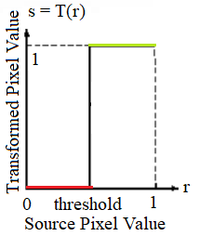
Image Thresholding
A way to create a binary image from a grayscale or full-color image.
This is typically done in order to separate "object" or foreground pixels from background pixels.
The transformation function used in image thresholding is
s = (L-1); if r≥ T here T is the threshold value.
0; else

Slide 15
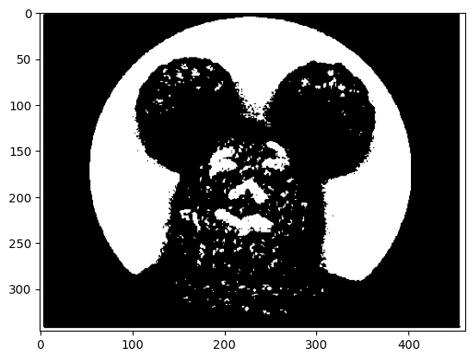
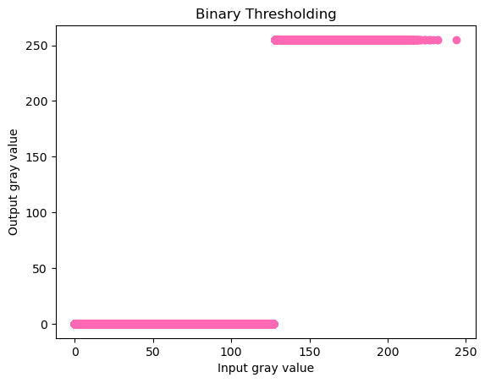
Example: Image Thresholding
T= 127
Let T = 127 (binary thresholding)
0 | 255 | 127
10 | 250 | 50
200 | 100 | 50
0 | 255 | 255
0 | 255 | 0
255 | 0 | 0

Slide 16
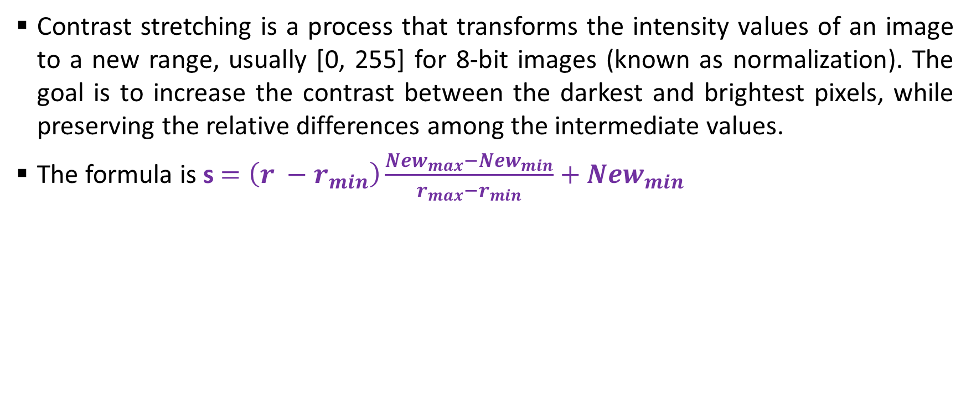
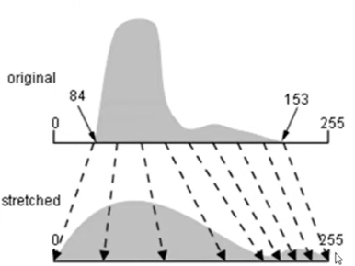
Contrast stretching

Slide 17
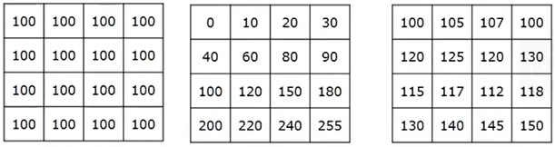
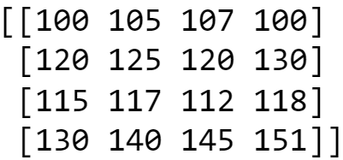
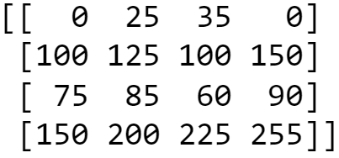
Example: Contrast stretching
No contrast
High contrast
Low contrast
After stretching (0 to 255)
Input Image
Transformed Image

Slide 18
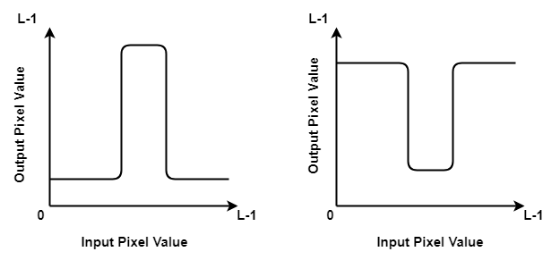
Gray-level slicing
Highlights a specific range of intensities in an image
Mostly used for enhancing features in satellite and X-ray images.
Grey-level slicing without background:
s = (L-1); if a < r < b here a and b are specific range of grey level.
0; else

Slide 19
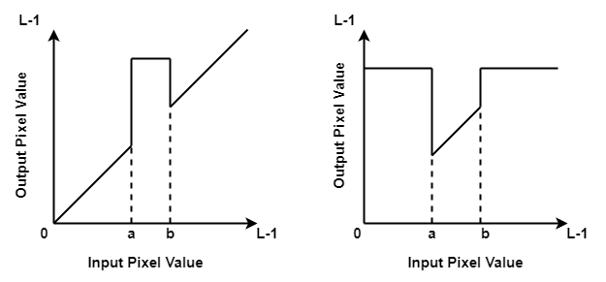
Gray-level slicing
Grey level slicing with background:
s = (L-1); if a < r < b here a and b are specific range of grey level.
r; else

Slide 20
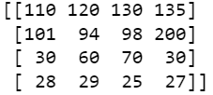
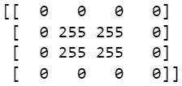
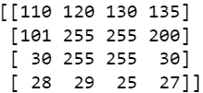
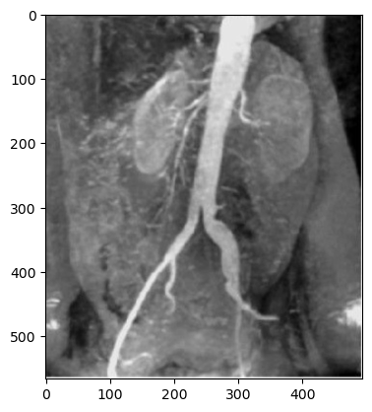
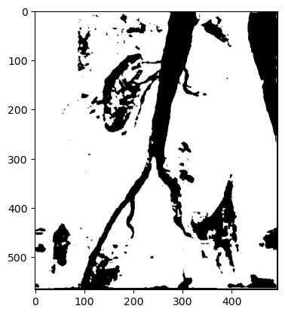
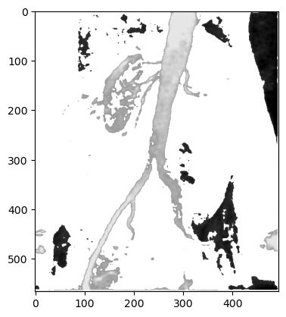
Example: Gray-level slicing
Grey-level slicing without background
Grey-level slicing with background
Input Image

Slide 21
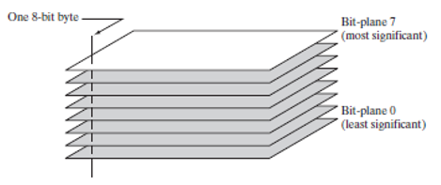
Bit plane slicing
Instead of highlighting gray-level range, it highlights the contribution made by each bit.
Most significant bits contain the majority of visually significant data.
Useful for image compression
Fig. Bit plane representation of a 8bit image

Slide 22
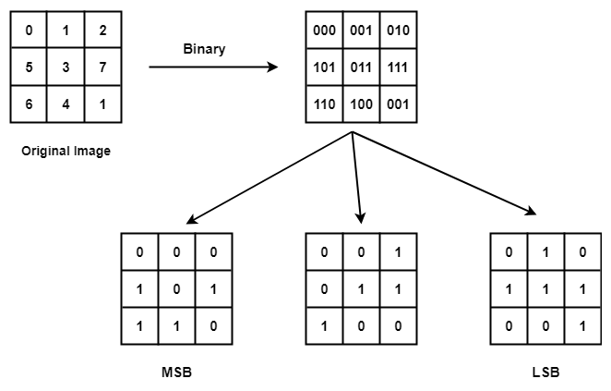
Example: Bit plane slicing
Fig. Bit Plane Slicing of a 3bit image

Slide 23
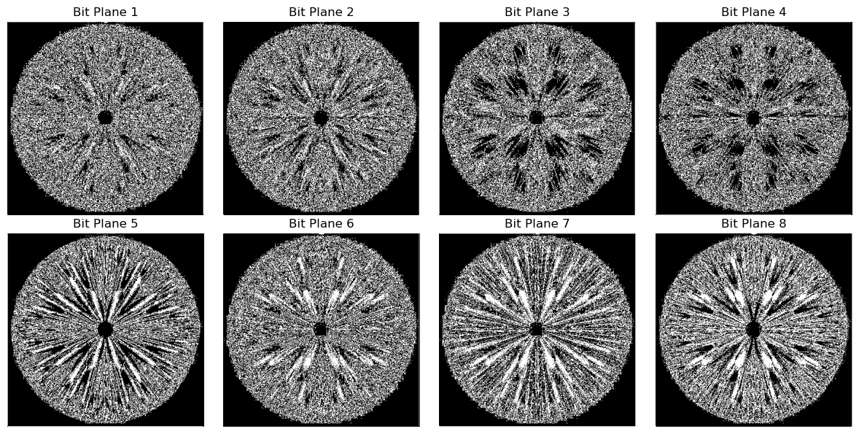
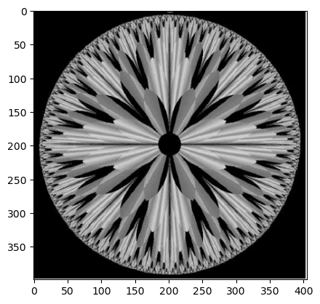
Example: Bit plane slicing
Only the higher order bits (top four) contain visually significant data. The other bit planes contribute the more subtle details.
Fig. The 8 Bit planes of an image

